Slide 1

Breast Tumor Classification
Using Histopathological Images
Analysis of the BreakHis Dataset using Deep Learning
Student Name : Sriharshini Thatiparthi
Student ID: 23070133
Github Link: https://github.com/st24aaq/Project-Breast-Tumor-Classification-Using-Histopathological-Images

Slide 2


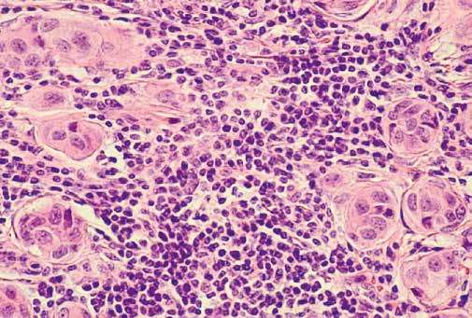
Introduction
Breast cancer (BC) is a highly diverse disease with various tumor types exhibiting different behaviors. Traditional classification relies on histological type and grade (e.g., Nottingham grading system).
However, conventional methods can be subjective. There is an urgent need for precise, automated diagnostic methods to support personalized treatment.
(Rakha, Tse and Quinn, 2023)

Slide 3


Problem Statement
Limitations of Current Methods
The AI Challenge
Traditional histopathological examination is the gold standard but is labor-intensive, time-consuming, and subjective. Interpretation can vary significantly between pathologists.
While CNNs offer automation, they face challenges with model generalization across magnifications. Furthermore, "black box" models lack transparency, necessitating Explainable AI (XAI) for clinical acceptance.
(Rakha, Tse and Quinn, 2023)

Slide 4






Objectives & Research Questions
Primary Objective
Key Question 1
Key Question 2
Create and train a CNN model to accurately classify benign vs. malignant breast tumor images using the BreakHis dataset.
How effectively do CNNs classify tumor tissues, and what is the variation in performance across different magnifications (200x vs 400x)?
Which visual characteristics influence classification, and can XAI methods like Grad-CAM provide interpretability?

Slide 5
Literature Review: Deep Learning
Golatkar et al. (2018)
Jannesari et al. (2019)
Addressed uninformative regions in H&E images. Used Inception-v3 CNN with transfer learning on nuclei-dense patches. Achieved 85% image-wise accuracy.
Focused on multi-classification of cancer subtypes. ResNet models outperformed Inception, achieving 98.7% accuracy for benign/malignant classification.
(Jannesari et al., 2019)
(Golatkar, Anand and Sethi, 2018)

Slide 6
Literature Review: ML Approaches
Amrane et al. (2018)
Assiri et al. (2020)
Compared classical classifiers on the Wisconsin dataset. KNN (k=3) achieved 97.51% accuracy, slightly outperforming Naïve Bayes (96.19%).
Proposed an ensemble method (Majority Voting of SLR, SVM, MLP) prioritizing the F3 score. Achieved a record high accuracy of 99.42%.
(Amrane et al., 2018)
(Assiri, Nazir and Velastin, 2020)

Slide 7
Comparative Analysis of Literature (Table 2.1)
Feature | Study 01 (Golatkar et al., 2018) | Study 02 (Jannesari et al., 2019) | Study 03 (Amrane et al., 2018) | Study 04 (Assiri, Nazir, and Velastin, 2020)
Datasets Used | BACH Challenge Dataset (H&E stained) | TMA and BreaKHis datasets (multiple cancer types and magnifications) | Wisconsin Breast Cancer Dataset (WBCD) (683 samples) | Wisconsin Breast Cancer Dataset (WBCD) (569 instances)
Classification Task | 4-Class (Normal, Benign, in situ, Invasive) & 2-Class (Non-cancer vs. Malignant) | 8 Sub-types (4 benign, 4 malignant) & 4 General Cancer Types | Binary (Benign/Malignant) | Binary (Benign/Malignant)
Core Models | Modified Inception-v3 CNN with Transfer Learning | ResNet (V1 50, 101, 152) and Inception (V1-V4) | k-Nearest Neighbor (KNN) (k=3) and Naïve Bayes (NB) | Ensemble (Majority Voting of SLR, SVM-SGD, MLP)
Best Accuracy Achieved | 85% (4-class image-level) 93% (2-class) | 99.8% (4 General Cancer Types, ResNet V1 50) 98.7% (Benign/Malignant, ResNet V1 152) | 97.51% (KNN) | 99.42% (Majority-based voting ensemble)

Slide 8
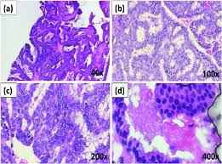
The BreakHis Dataset
•
Source: Instituto Federal de Educação, Brazil.
•
Input: RGB Microscopic images (224 x 224 pixels).
•
Magnifications: 40x, 100x, 200x, and 400x.
•
Labels: Binary classification (Benign / Malignant).
•
Content: Derived from breast tumor tissue slides.

Slide 9
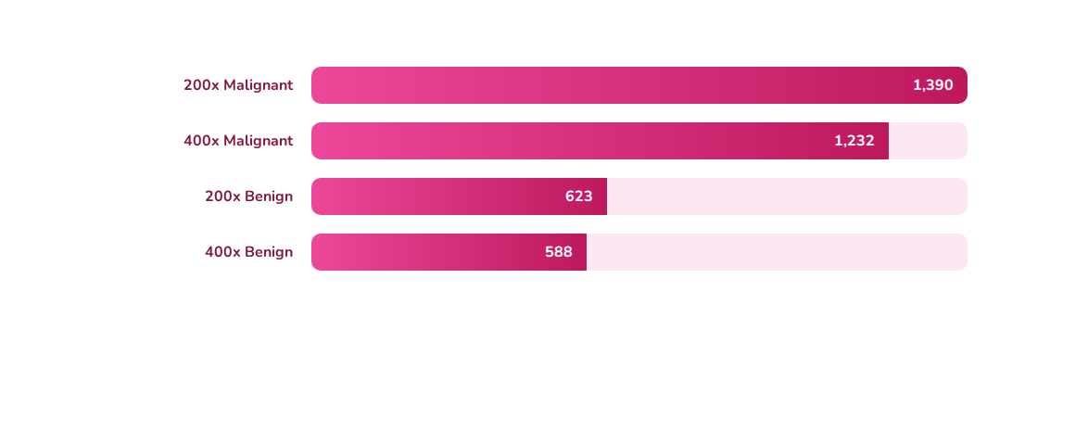
Image Distribution by Class & Magnification
The dataset shows a class imbalance with significantly more Malignant samples than Benign samples across both magnifications.

Slide 10
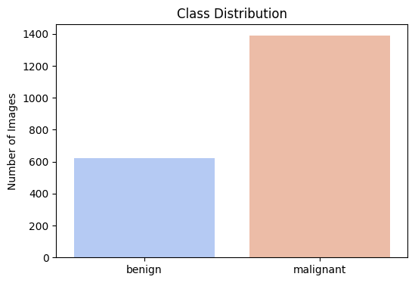
Total Class Distribution
Malignant (68%)
Benign (32%)
Total Images: 3,833 (Combined 200x & 400x)

Slide 11
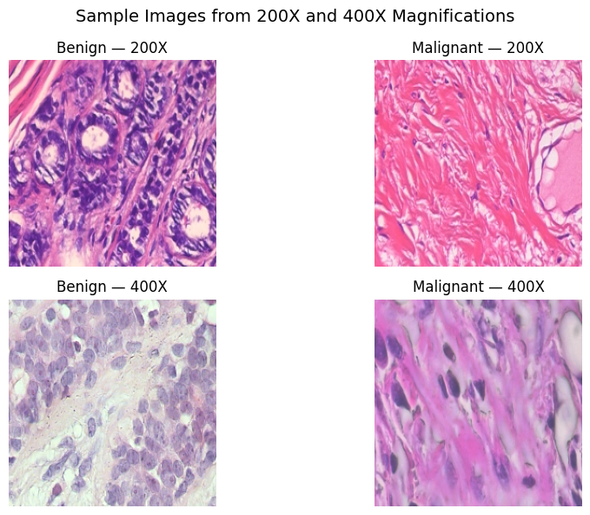
Dataset Samples & Summary (Table 3.1)
Image Count Summary by Magnification
Magnification Factor | Tumor Class | Image Count
200× | Benign | 623
Malignant | 1,390
Total | 2,013
400× | Benign | 588
Malignant | 1,232
Total | 1,820
Sample Images after magnification
The most challenging subset (200x) was selected for initial model training due to its higher total sample count.

Slide 12
Methodology & Approach
Data Preparation & Training (200X)
Transfer Learning with CNNs
•
Magnification Focus: Initial training focused on the 200X subset (2,013 images).
•
Base Models: VGG16, ResNet50, and EfficientNetB0 (ImageNet pre-trained) were used as feature extractors.
○
Rotation (up to 25 degrees)
•
Strategy: Weights of the pre-trained layers were frozen. A new classification head (Global Average Pooling, Dense layer, Dropout) was added.
○
Shifts, Shears, Zooms
○
Horizontal Flipping
•
Why Transfer Learning? To leverage vast knowledge learned from natural images (ImageNet) and apply it to the medical domain (histopathology), mitigating the risk of overfitting due to limited medical data.
•
Training: All models were trained for 10 epochs using the Adam optimizer.

Slide 13
Experimental Results
Model Performance Comparison (Validation Set)
Model | Accuracy (Validation) | Precision (Malignant) | Recall (Malignant) | F1-Score (Malignant)
VGG16 | 67.66% | 0.6953 | 0.9604 | 0.8066
ResNet50 | 69.15% | 0.6915 | 1.0000 | 0.8176
EfficientNetB0 | 69.15% | 0.6915 | 1.0000 | 0.8176
Key Findings
•
High Recall (100% for ResNet & EfficientNet): The models successfully identified all true Malignant (cancerous) cases in the validation set. This is crucial in medical diagnostics to minimize False Negatives.
•
Accuracy: All models achieved an accuracy of approximately 67% - 69%, indicating challenges in separating Benign images (class imbalance likely leads to bias towards the larger Malignant class).
•
Precision: The models struggled with precision for the benign class, leading to a higher number of False Positives (classifying benign as malignant).

Slide 14
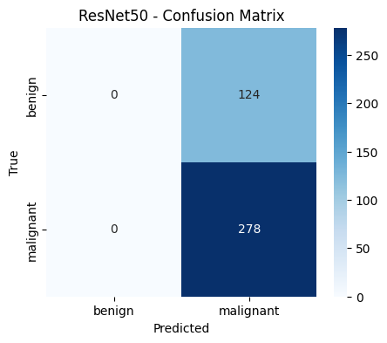
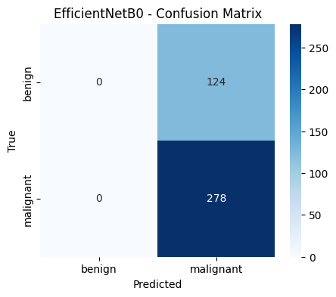
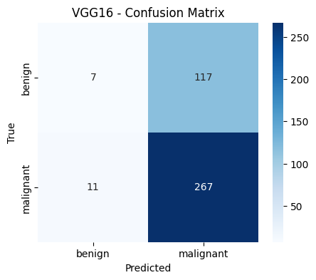
Detailed Performance: Confusion Matrix Analysis
Insight: The "Confusion Matrix" reveals a strong bias towards the majority class (Malignant). ResNet50 defaulted to predicting 'Malignant' for nearly all samples, achieving 100% recall but 0 specificity. VGG16 attempted to distinguish classes but suffered from many False Positives.

Slide 15





What Comes Next?
The immediate next steps will focus on addressing the remaining research questions to ensure a robust and interpretable diagnostic tool.
1. Explainability (XAI)
2. Magnification Analysis
3. Probability Comparison
Deploying Grad-CAM and LIME to uncover which visual features (texture, shape, pattern) most significantly influence the model's classification.
Evaluating variation in performance at 400x magnification and testing the models' ability to generalize across different zoom levels.
Conducting a deep dive into expected vs. actual class probabilities to rigorously validate the classification effectiveness.

Slide 16
References
· Amrane, M. et al. (2018) “Breast cancer classification using machine learning,” 2018 Electric Electronics, Computer Science, Biomedical Engineerings’ Meeting, EBBT 2018, pp. 1–4. Available at: https://doi.org/10.1109/EBBT.2018.8391453.
· Assiri, A.S., Nazir, S. and Velastin, S.A. (2020) “Breast Tumor Classification Using an Ensemble Machine Learning Method,” Journal of Imaging, 6(6). Available at: https://doi.org/10.3390/JIMAGING6060039.
· Dai, X. et al. (2017) “Breast cancer cell line classification and Its relevance with breast tumor subtyping,” Journal of Cancer, 8(16), pp. 3131–3141. Available at: https://doi.org/10.7150/jca.18457.
· Golatkar, A., Anand, D. and Sethi, A. (2018) “Classification of Breast Cancer Histology Using Deep Learning,” Lecture Notes in Computer Science (including subseries Lecture Notes in Artificial Intelligence and Lecture Notes in Bioinformatics), 10882 LNCS, pp. 837–844. Available at: https://doi.org/10.1007/978-3-319-93000-8_95.
· Jannesari, M. et al. (2019) “Breast Cancer Histopathological Image Classification: A Deep Learning Approach,” Proceedings - 2018 IEEE International Conference on Bioinformatics and Biomedicine, BIBM 2018, pp. 2405–2412. Available at: https://doi.org/10.1109/BIBM.2018.8621307.
· Rakha, E.A., Tse, G.M. and Quinn, C.M. (2023) “An update on the pathological classification of breast cancer,” Histopathology, 82(1), pp. 5–16. Available at: https://doi.org/10.1111/his.14786.

Slide 17
Questions?
Thank you for your attention.

